Slide 1
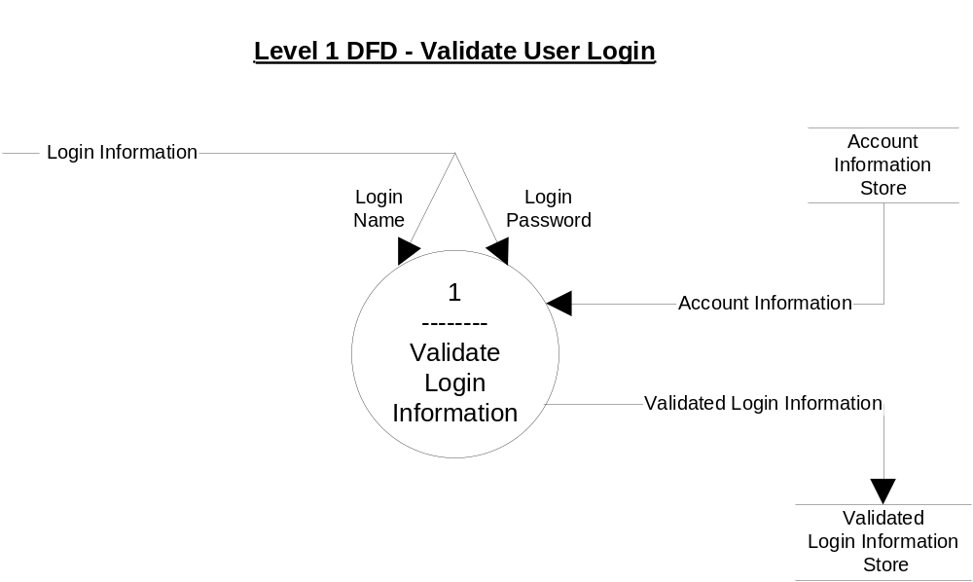

Slide 2
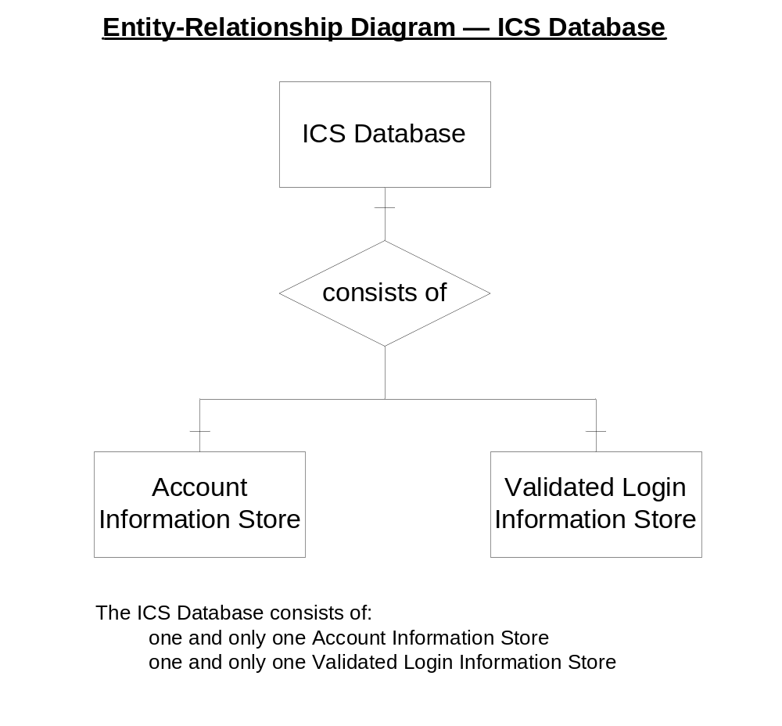

Slide 3
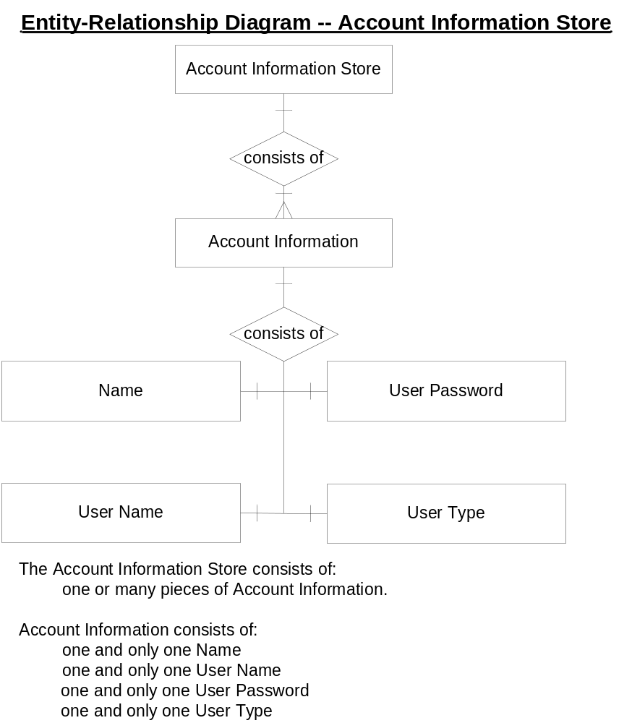

Slide 4
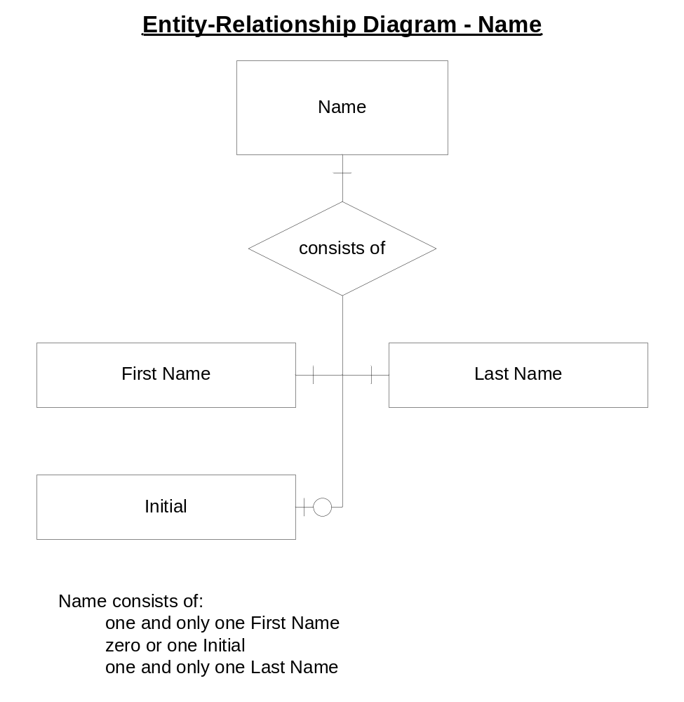

Slide 5
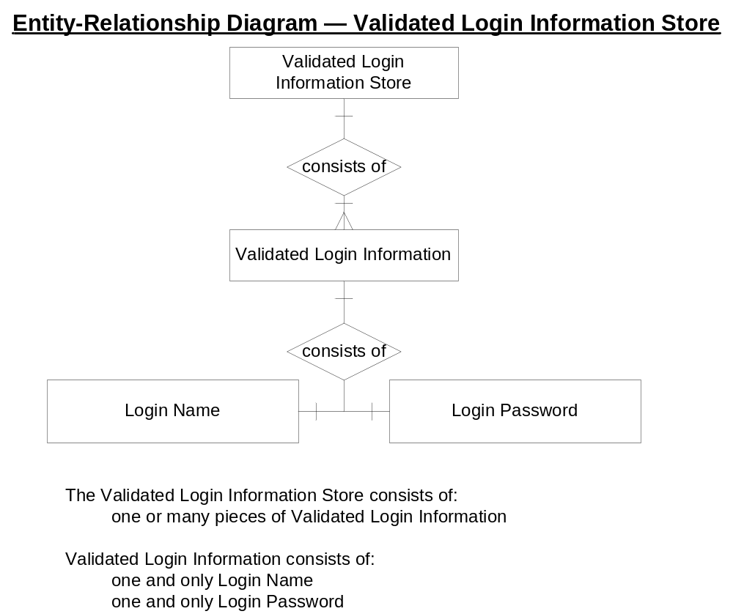

Slide 6
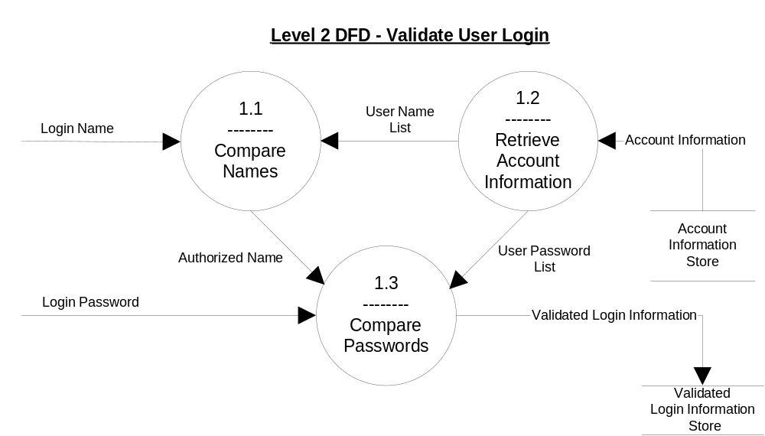
A Level Two DFD
Notice the Balancing of the DFDs between levels

Slide 7
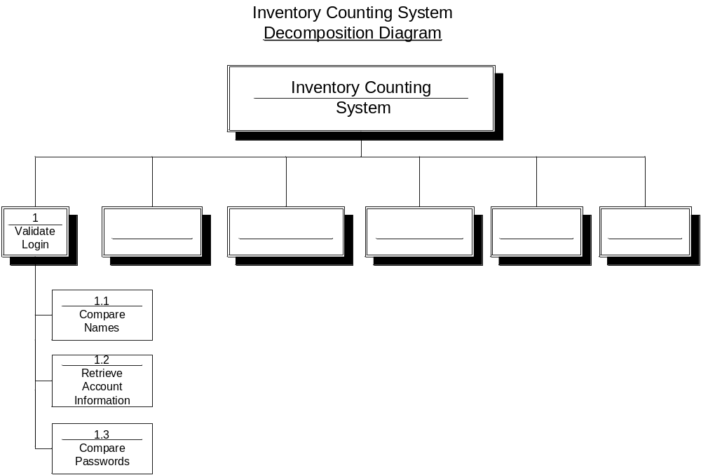
Horizontal and Vertical Partitioning
Course Text: Page 350/323

Slide 8
A Level Two DFD
The data flows circled are not in the Data Dictionary, but they must be accounted for; otherwise, we don’t understand the problem we are trying to solve.

Slide 9
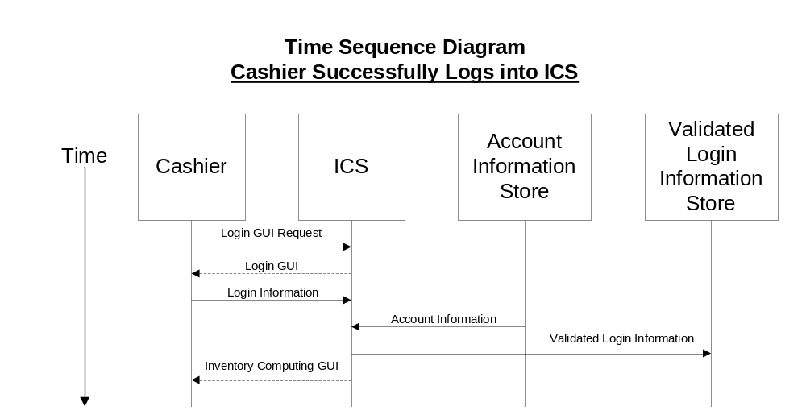

Slide 10
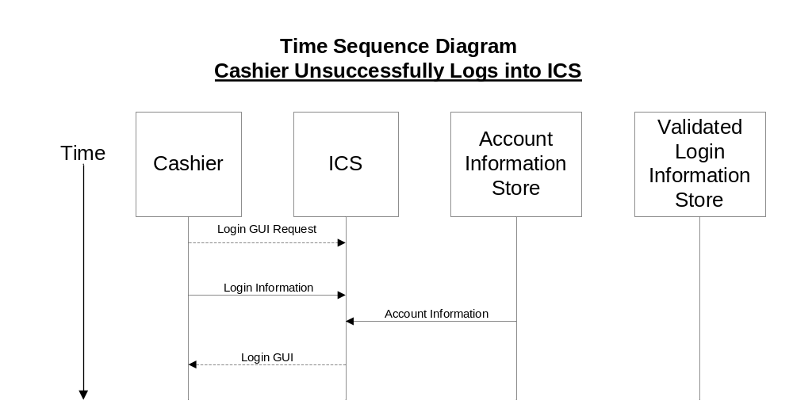

Slide 11

Given a sentence of short narrative, use Cardinality Notations (Figure 7.3 course text) to create an ERD
Examples:
Example Midterm Question and its solution.
Problem:
Draw an ERD with its correct Cardinality Notations for the following:
A student at Algonquin College is enrolled in one or many courses.
A course has enrollment of one or many students.
Solution:
Given the above ERD, could you write the bidirectional narratives associated with it?

